Slide 1
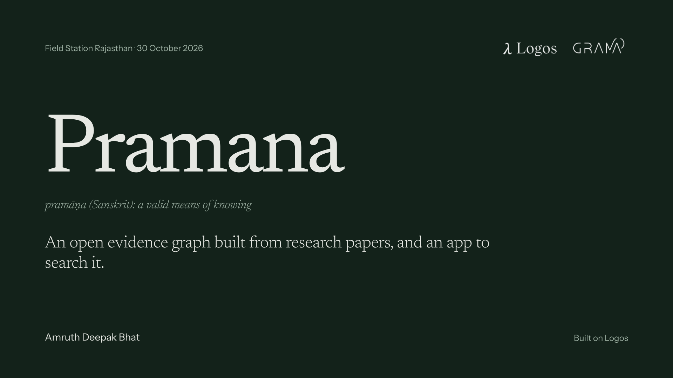
Notes:
Pramana: Sanskrit for a valid means of knowing. It reads papers down to the numbers they report and puts every claim beside them.

Slide 2
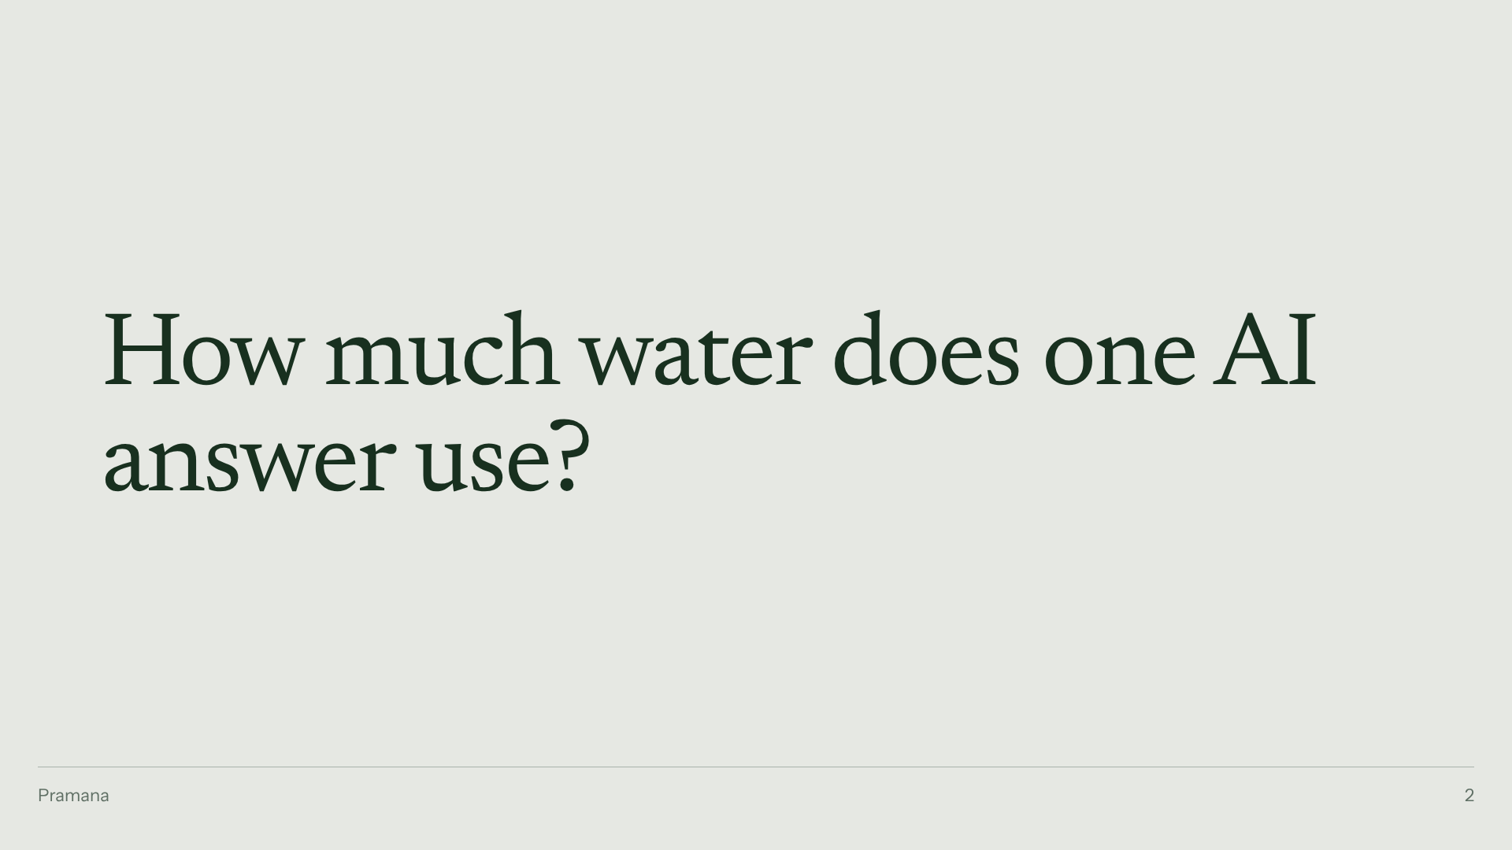
Notes:
Ask the room. Hands up for a bottle. A spoonful. A drop.

Slide 3
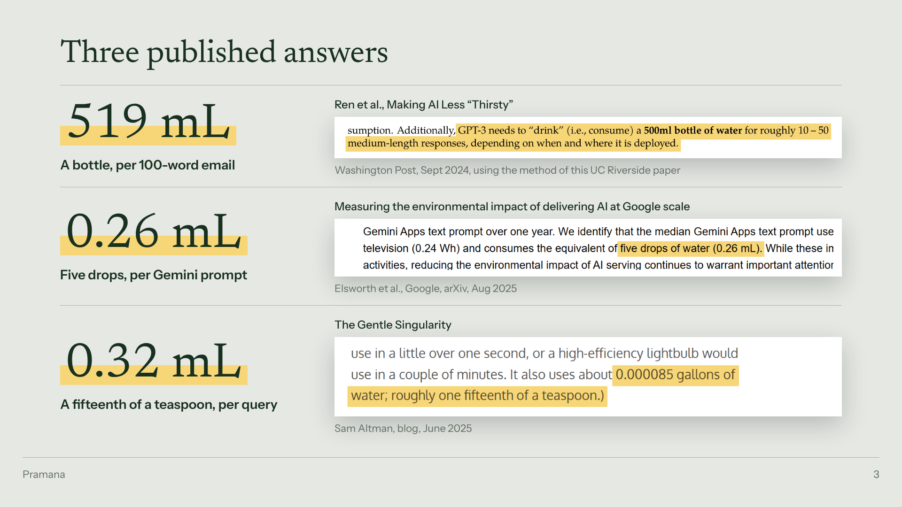
Notes:
Three published answers. The Post with UC Riverside: a bottle per email. Google: five drops. Altman: a fifteenth of a teaspoon.

Slide 4
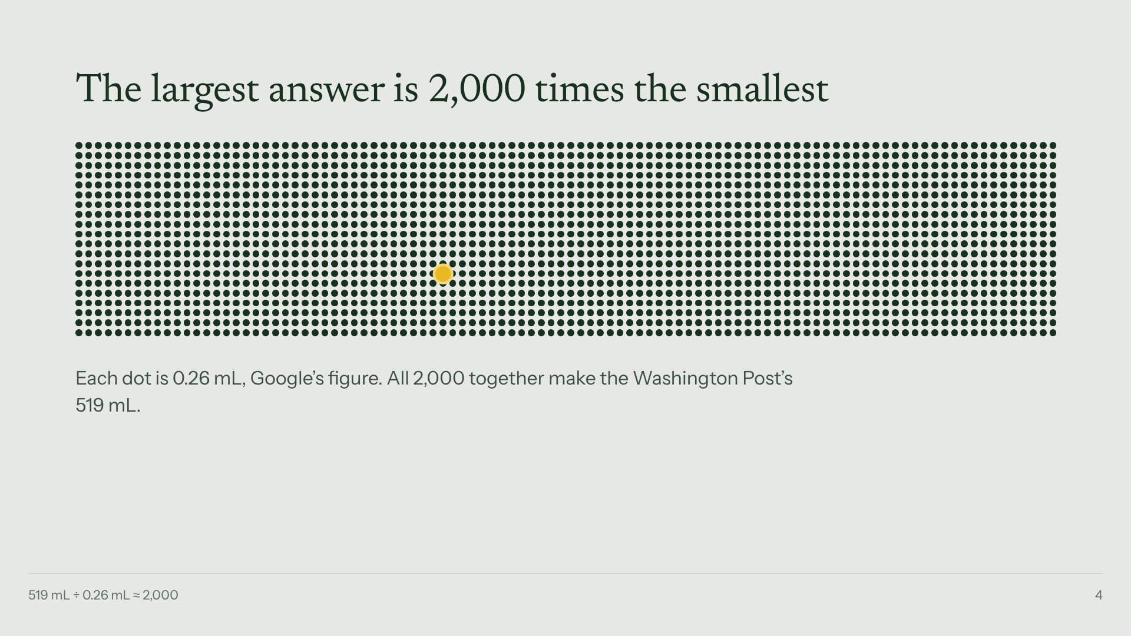
Notes:
The largest is 2,000 times the smallest. Let it sit.

Slide 5
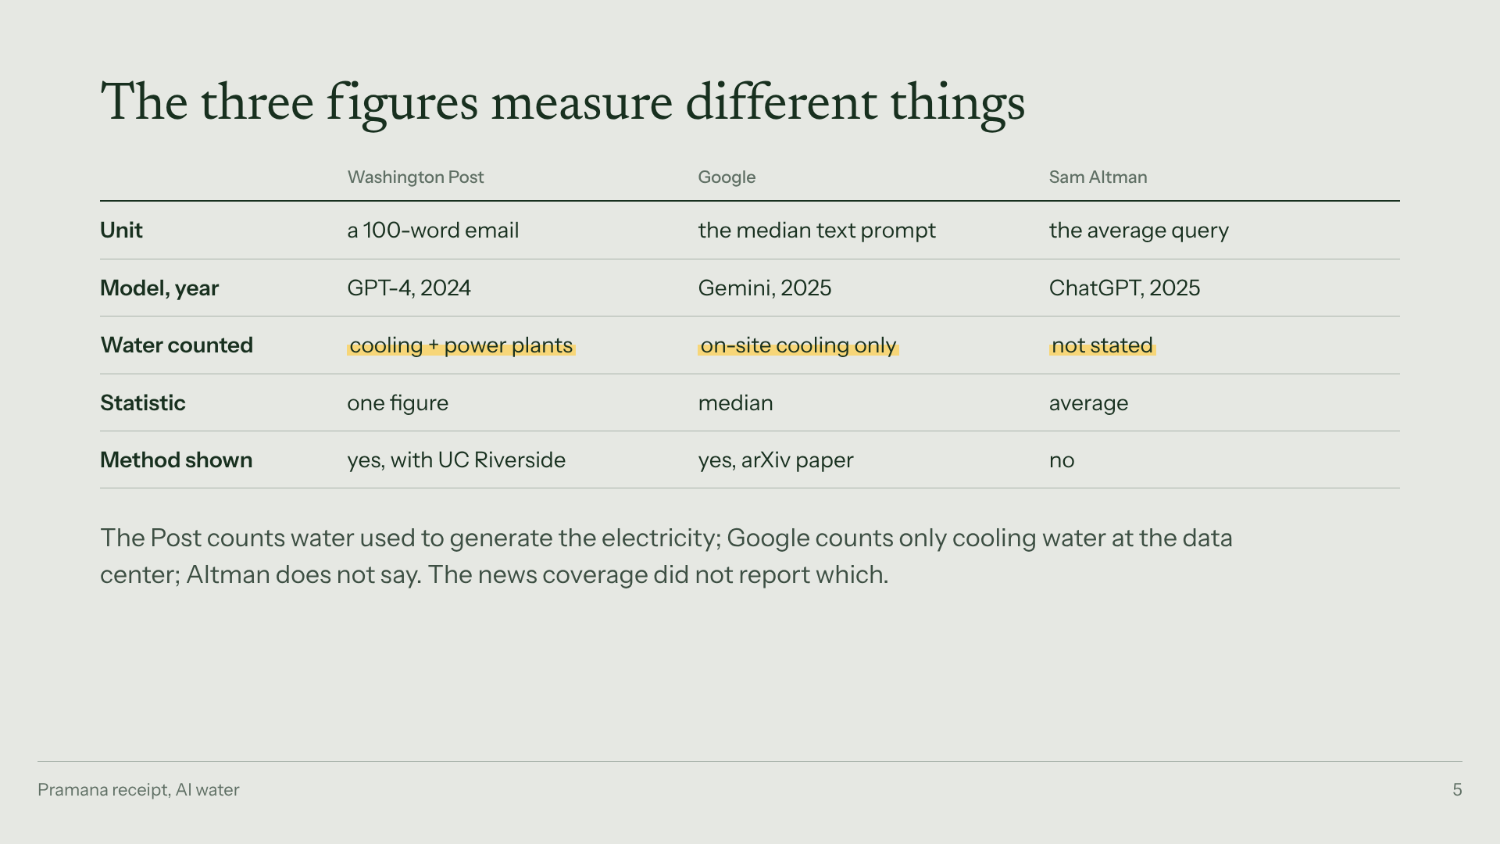
Notes:
They measure different things. Point at the Water counted row.

Slide 6
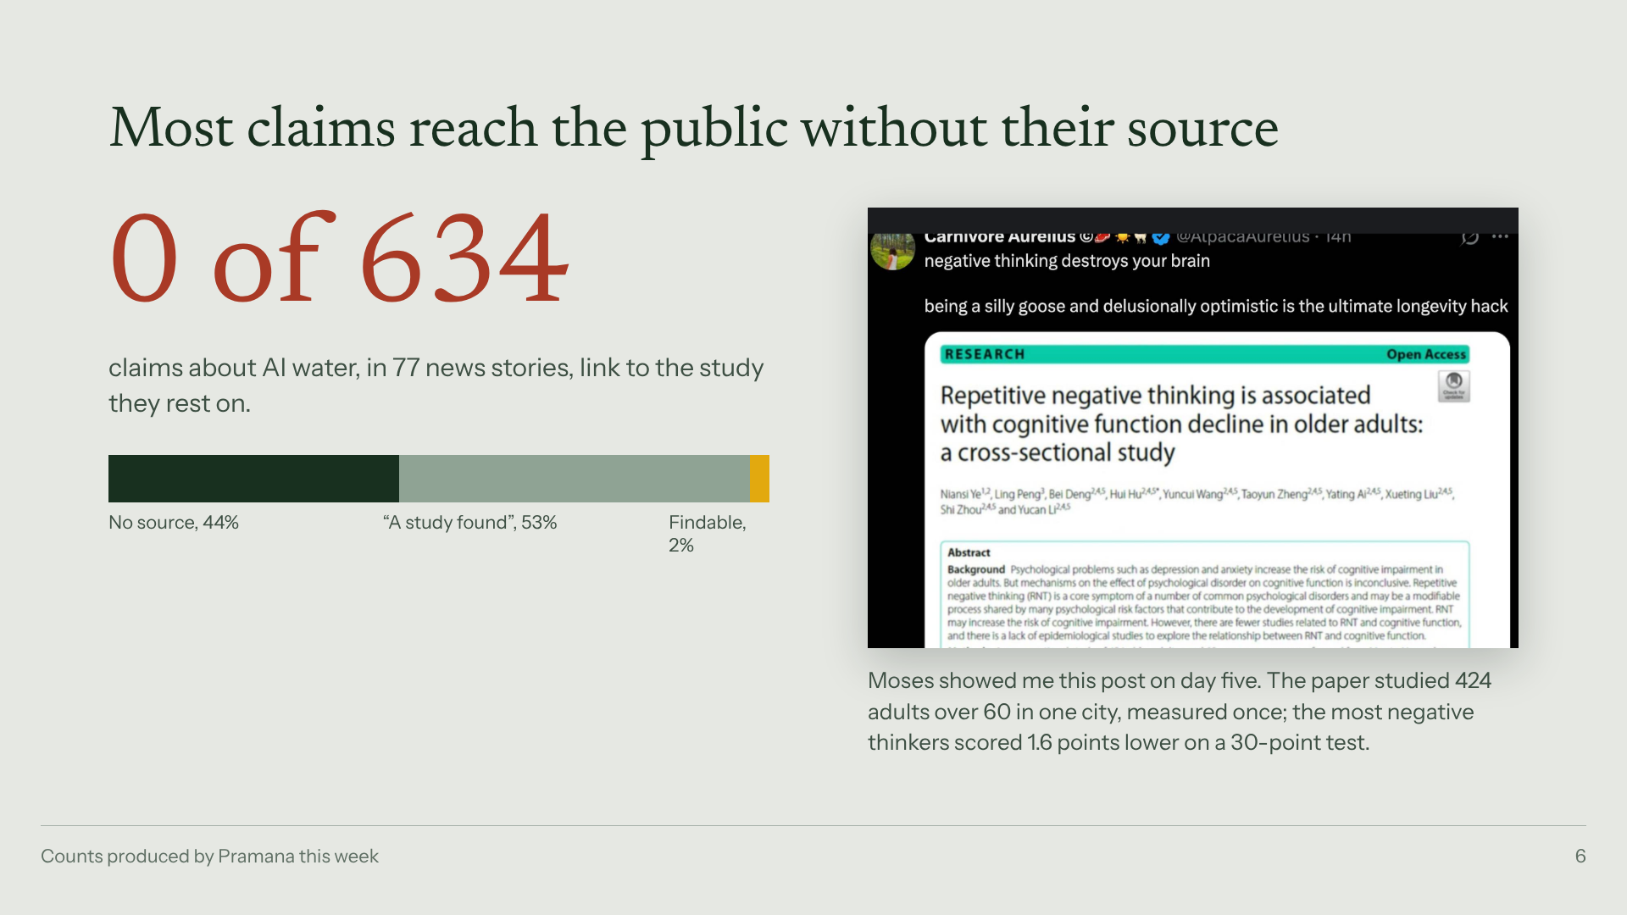
Notes:
Not a water problem. 634 news claims, none linked to the study. Moses's post: a 1.6-point association in 424 people became destroys your brain.

Slide 7
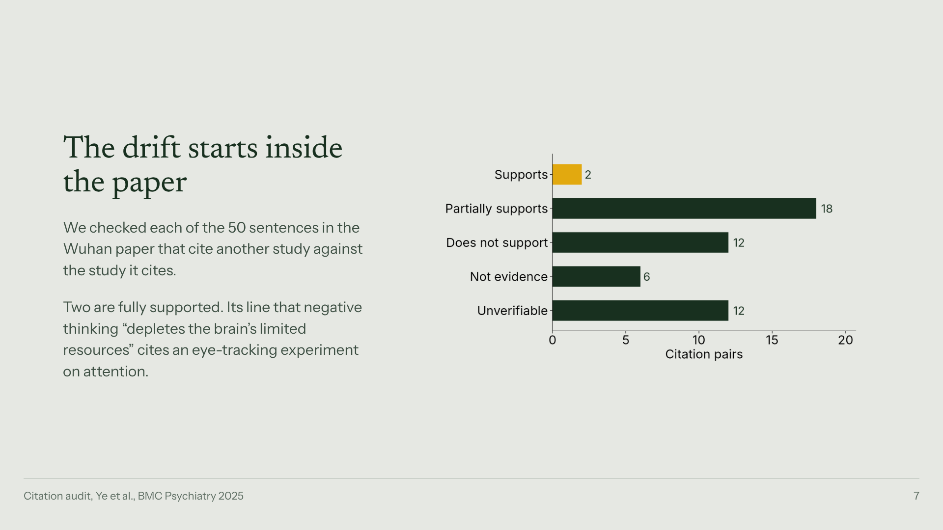
Notes:
Even inside the paper: 2 of 50 citations fully support their sentence.

Slide 8
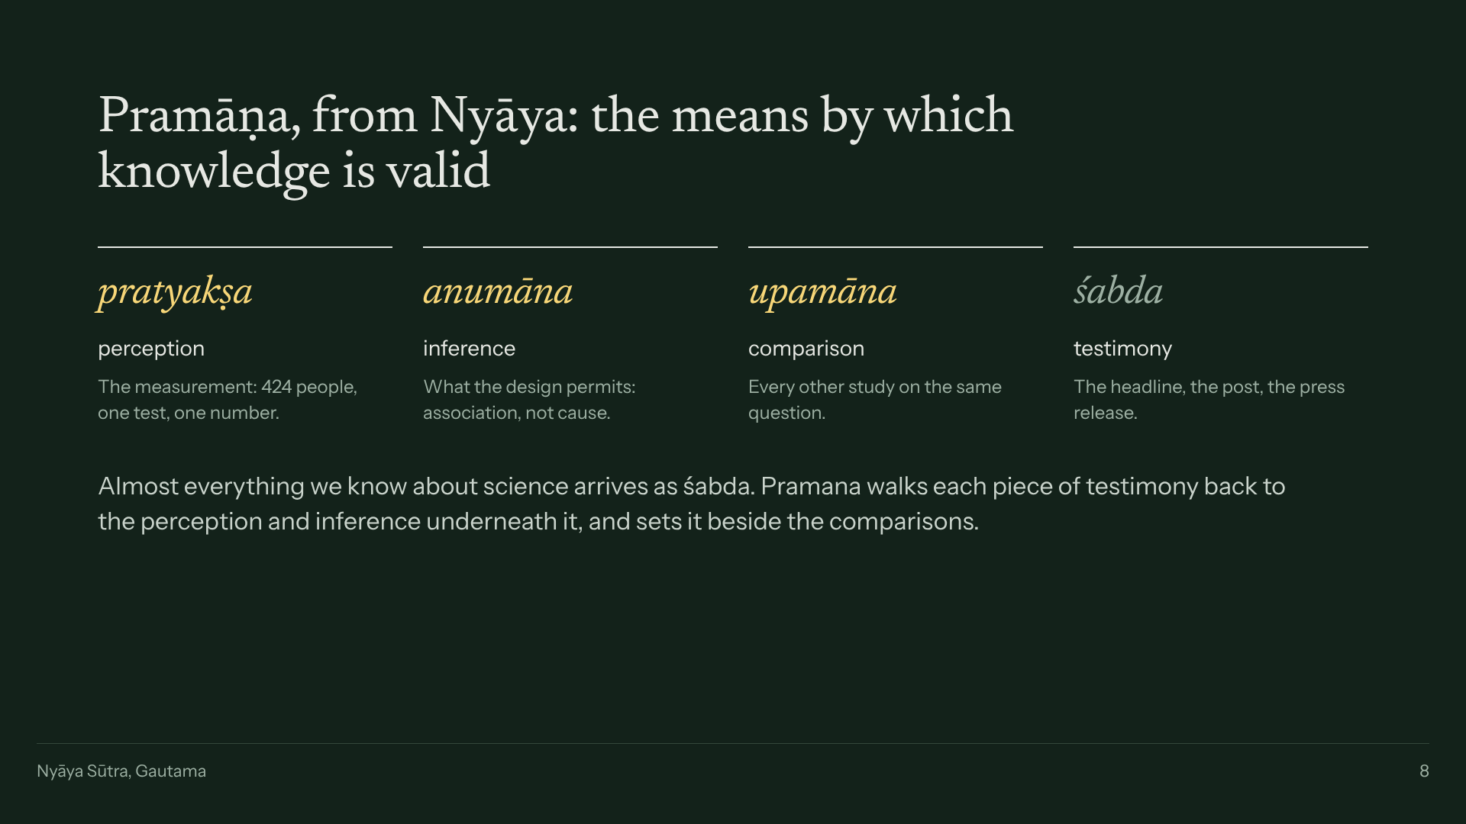
Notes:
The name. Nyaya's four means of valid knowledge. News is testimony; Pramana walks it back to measurement and inference.

Slide 9
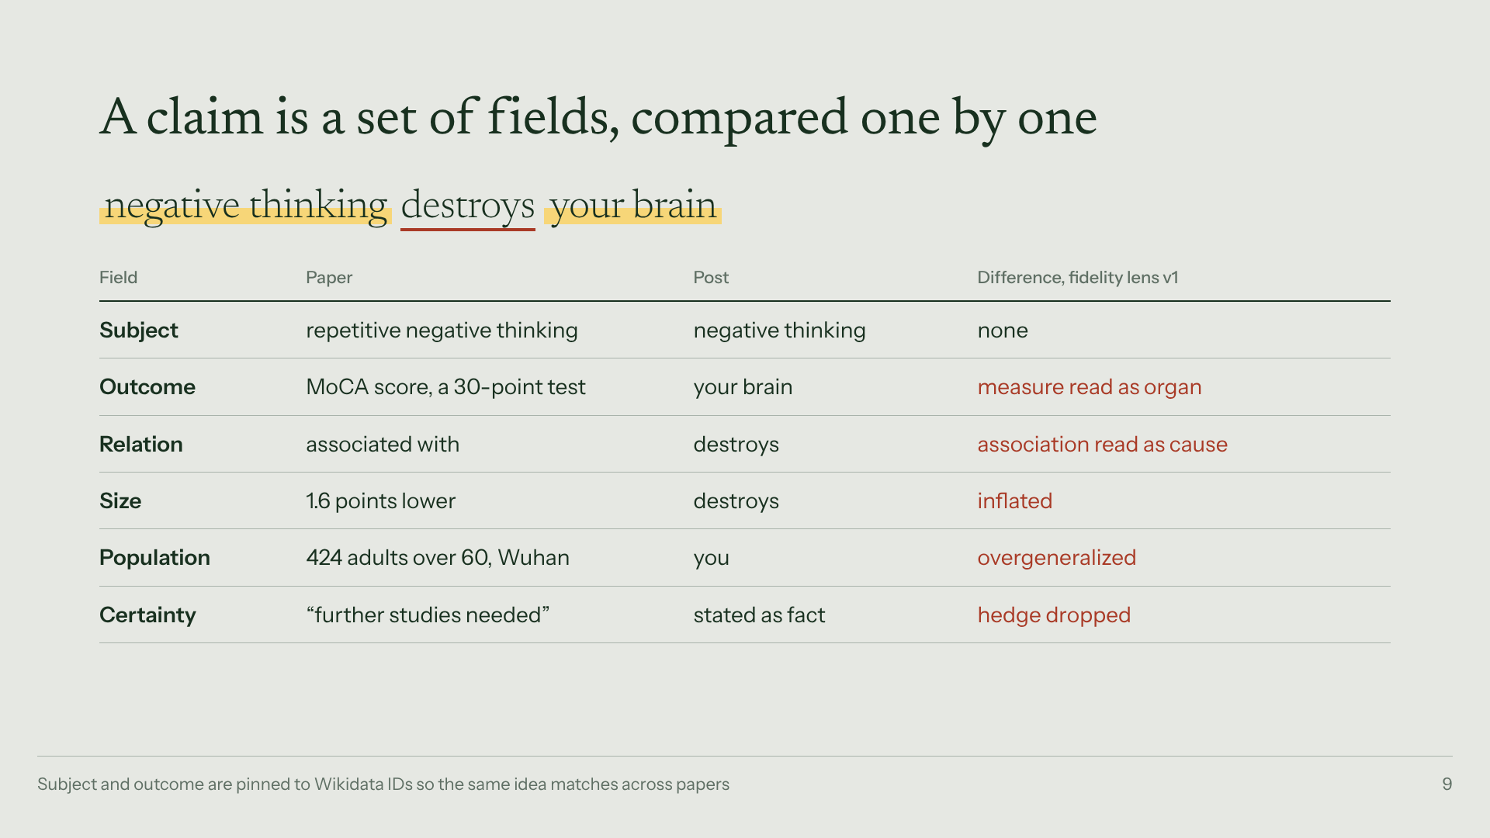
Notes:
A claim is a set of fields. Point at Relation: associated with became destroys.

Slide 10
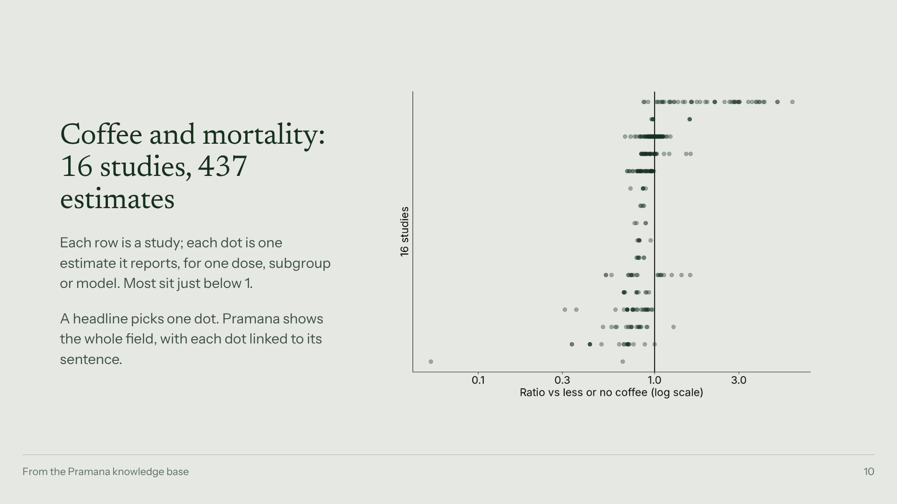
Notes:
What evidence looks like when you see all of it. A headline picks one dot.

Slide 11
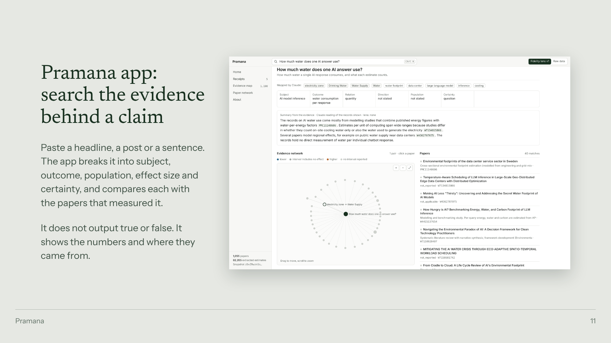
Notes:
The app: paste a claim, see the receipt.

Slide 12
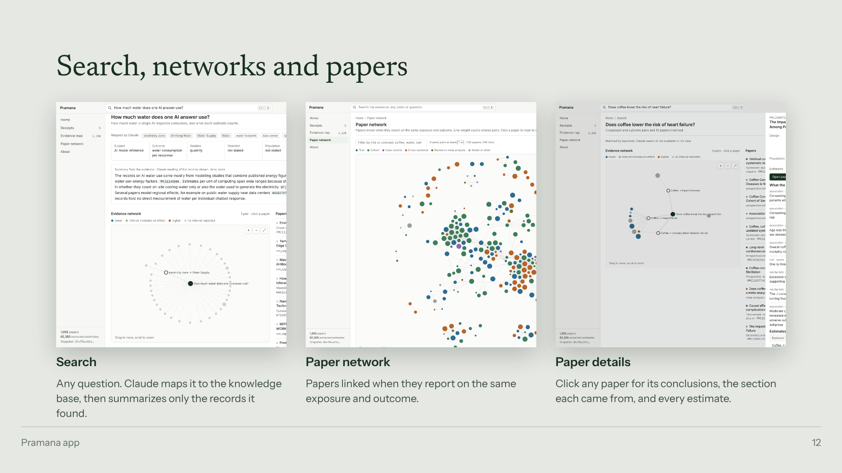
Notes:
Three views: check, receipts, evidence map.

Slide 13
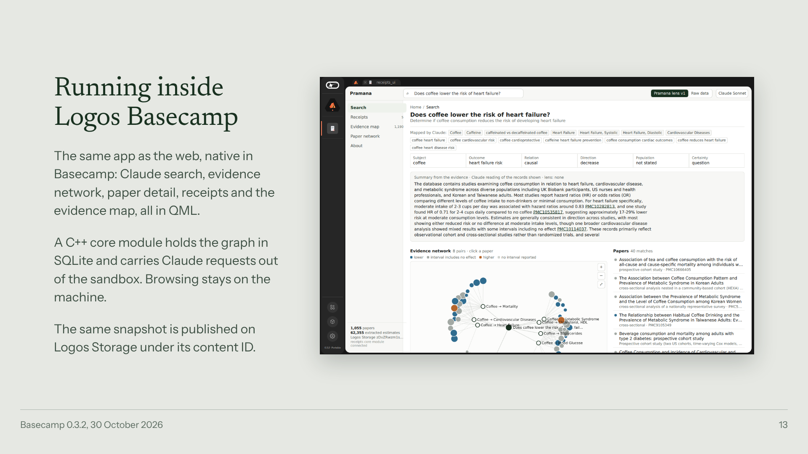
Notes:
The same graph inside Logos Basecamp: a C++ core module with SQLite and a QML screen. Queries stay on the machine.

Slide 14
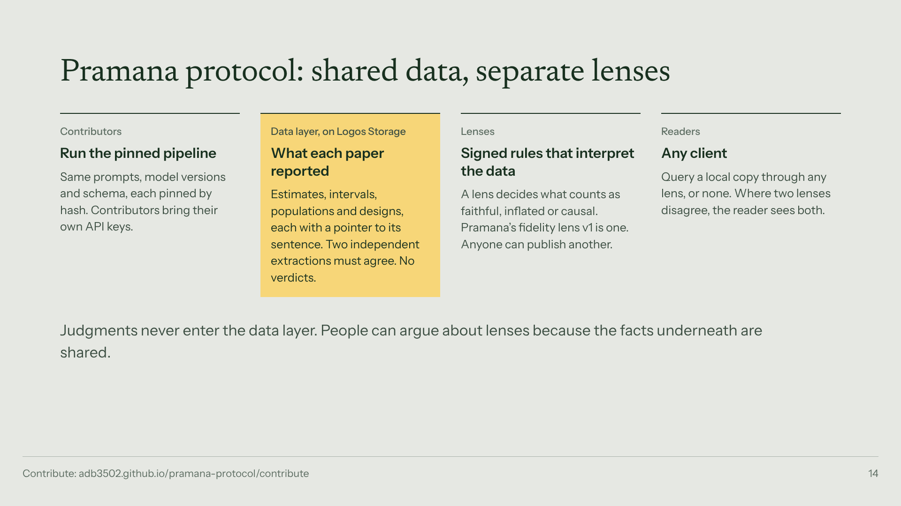
Notes:
The protocol has two layers. Data: what each paper reported, extracted by anyone with their own keys, accepted only when two extractions agree. Lenses: signed rules that interpret the data; my receipts are one lens. Who decides what is true? Nobody. The data records what was measured; every interpretation carries its author.

Slide 15
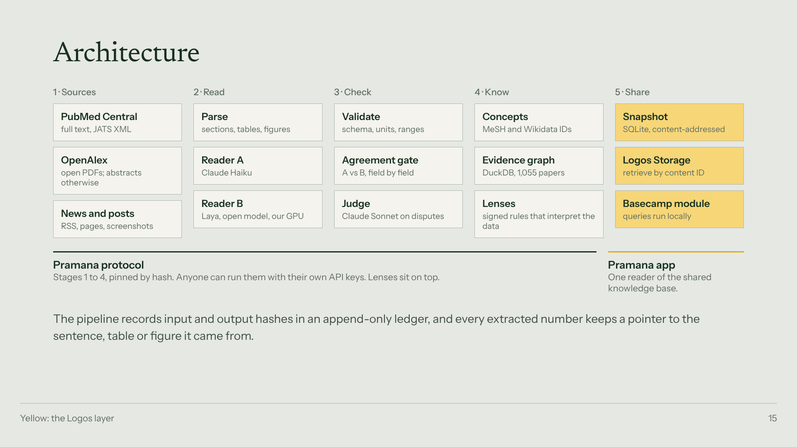
Notes:
Architecture. Stages 1 to 4 are the protocol; stage 5 is where Logos does the work.

Slide 16
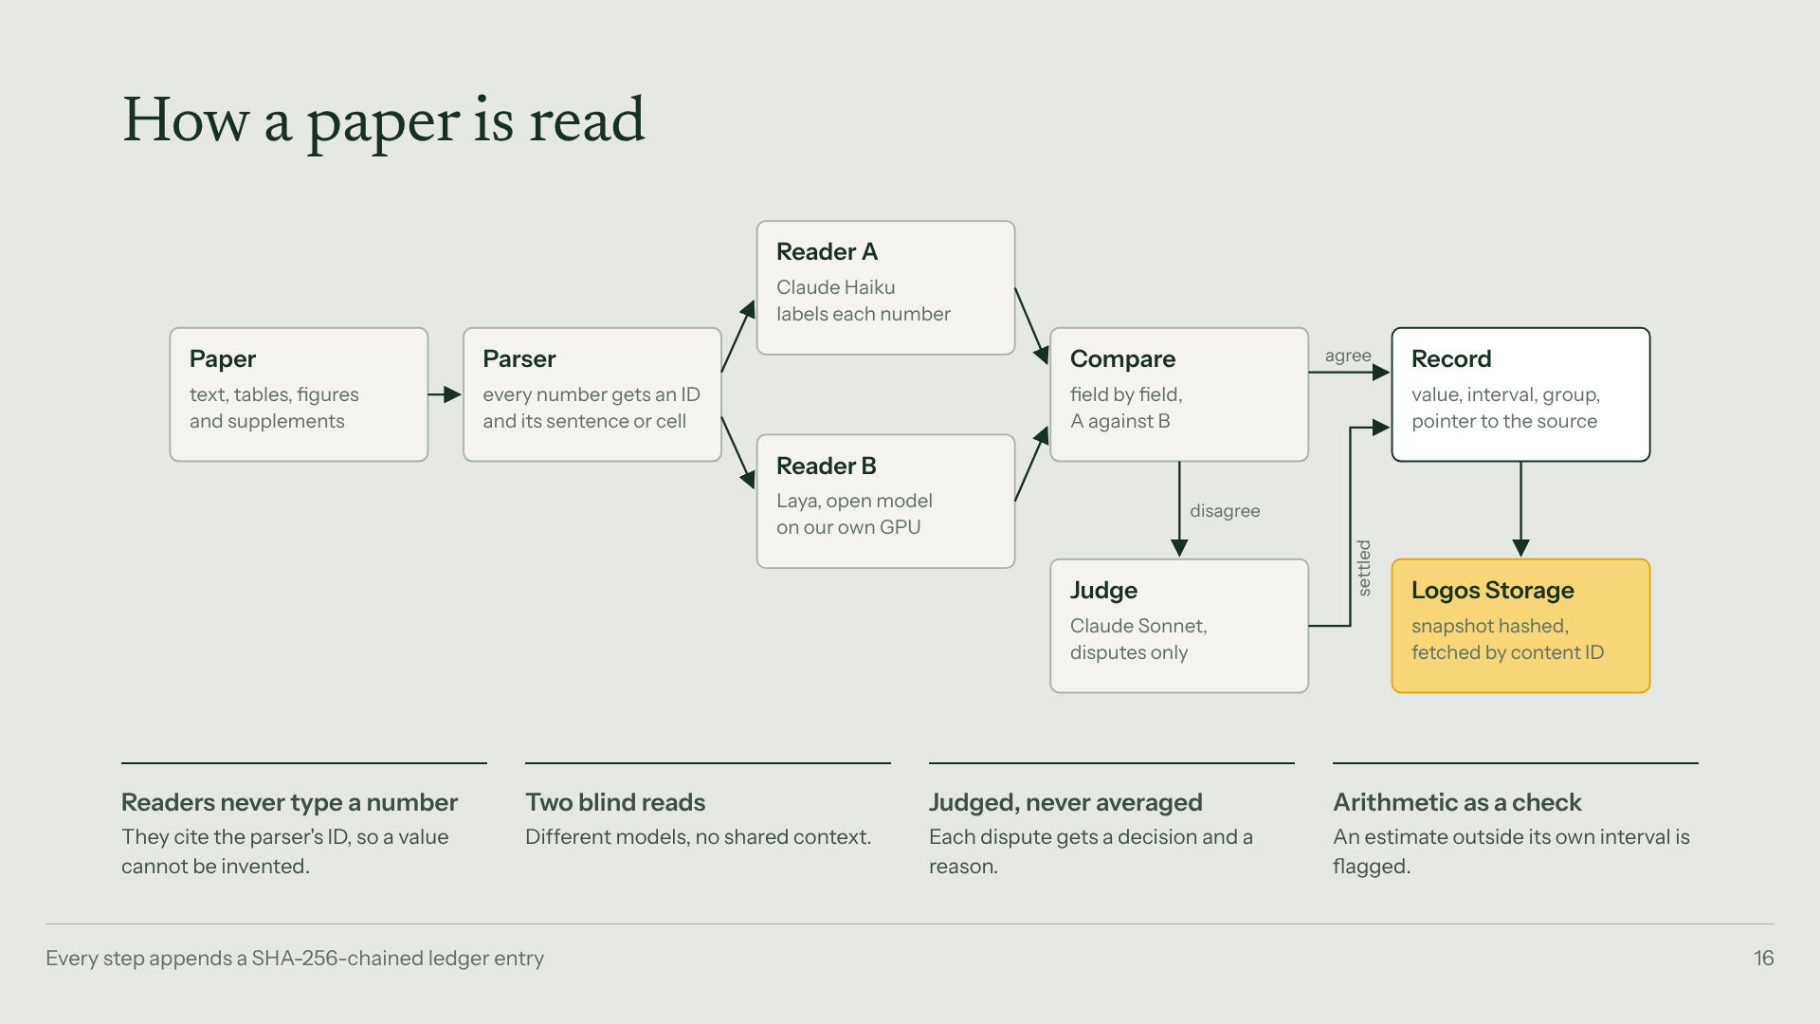
Notes:
How a paper is read. Readers never type a number: they cite the parser ID. Two blind reads, disputes go to the judge, arithmetic catches errors in the papers themselves.

Slide 17
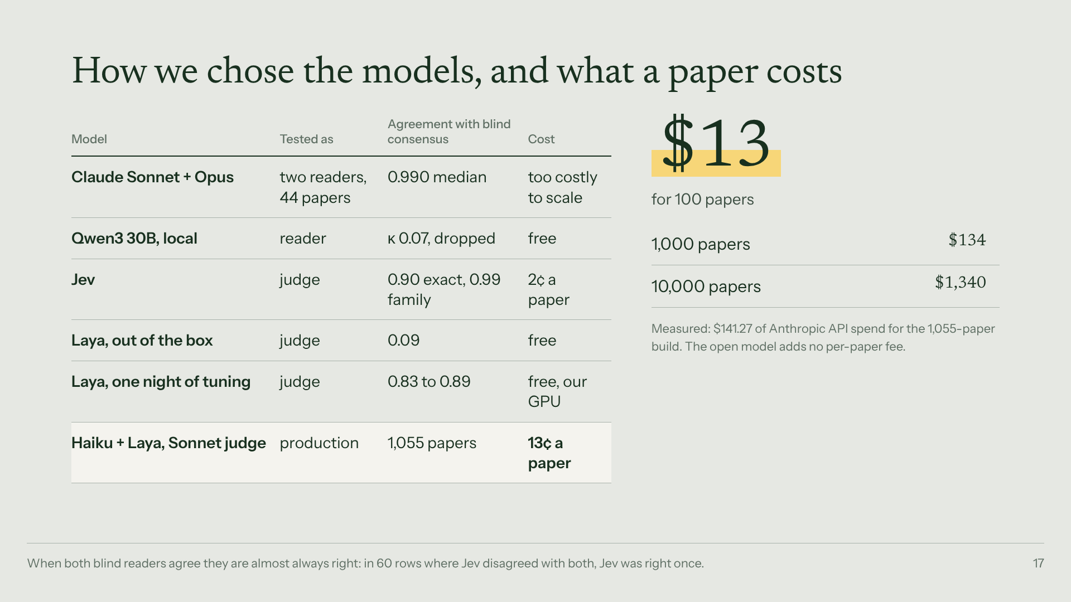
Notes:
How we chose the models. Sonnet plus Opus agreed 99% but cost too much to scale. Qwen collapsed as a reader. Laya went from useless to 0.83 to 0.89 after one night of tuning. Production: Haiku plus Laya, Sonnet on disputes. 13 cents a paper: 100 papers for 13 dollars.

Slide 18
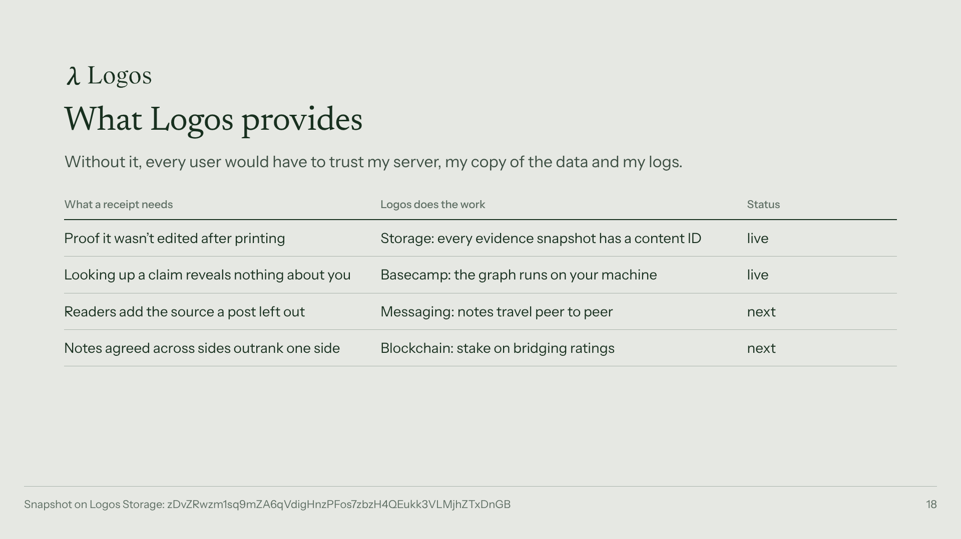
Notes:
Could this exist without Logos? A central version could, and everyone would have to trust my server. Say which rows run today.

Slide 19
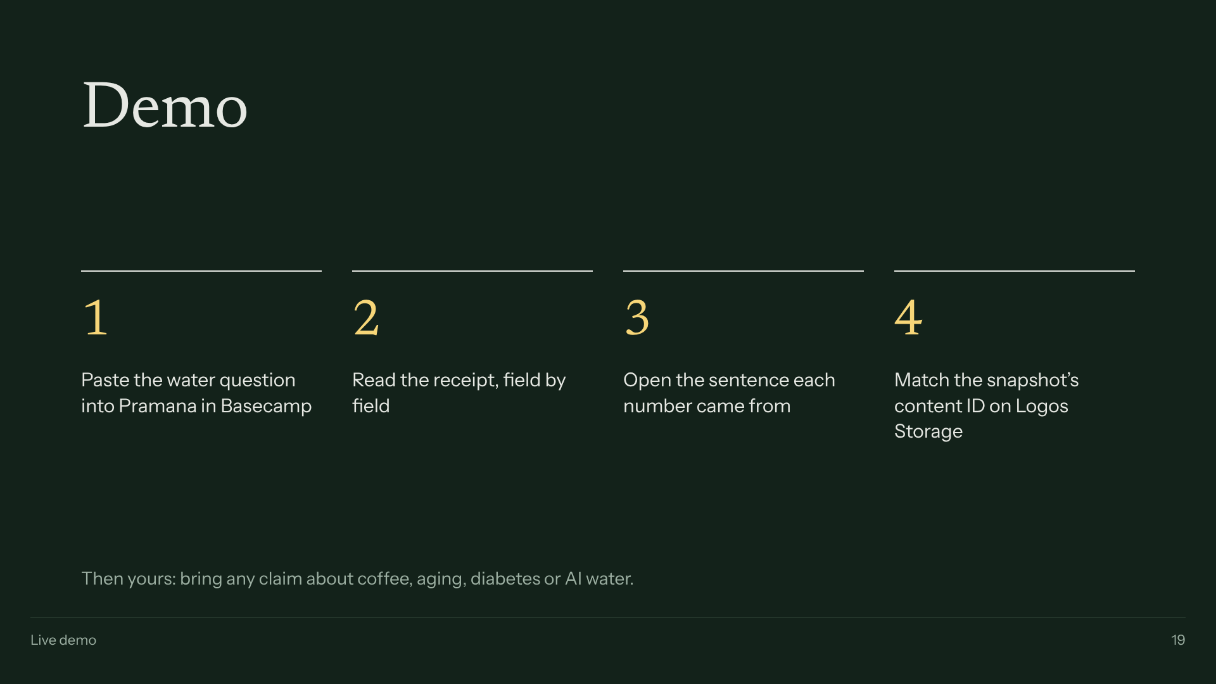
Notes:
Demo, 2 minutes. Water question first. Then a judge's claim. Say what is mocked before anyone asks.

Slide 20
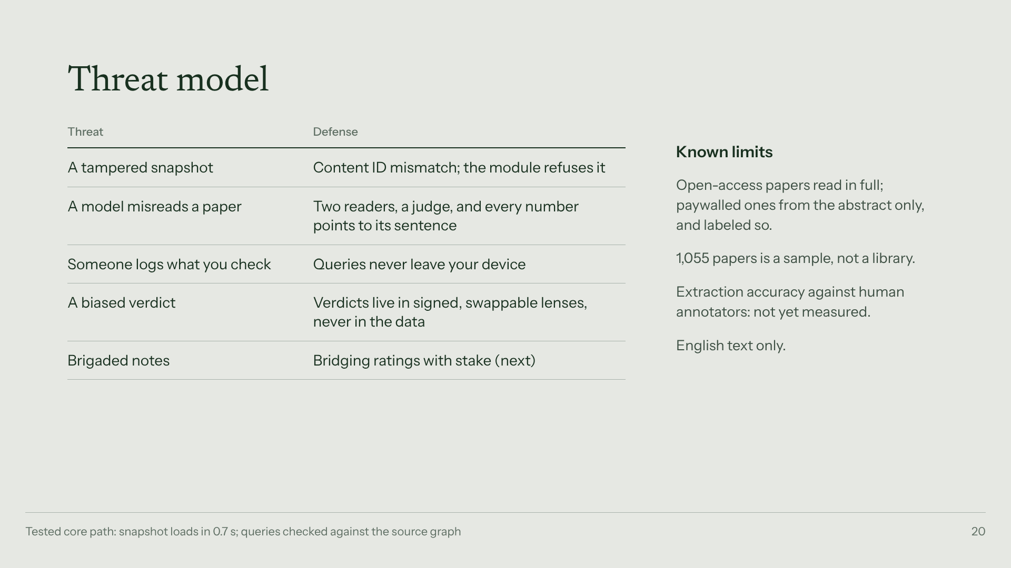
Notes:
Threat model. Every value points to a sentence, so a wrong number is a findable bug.

Slide 21
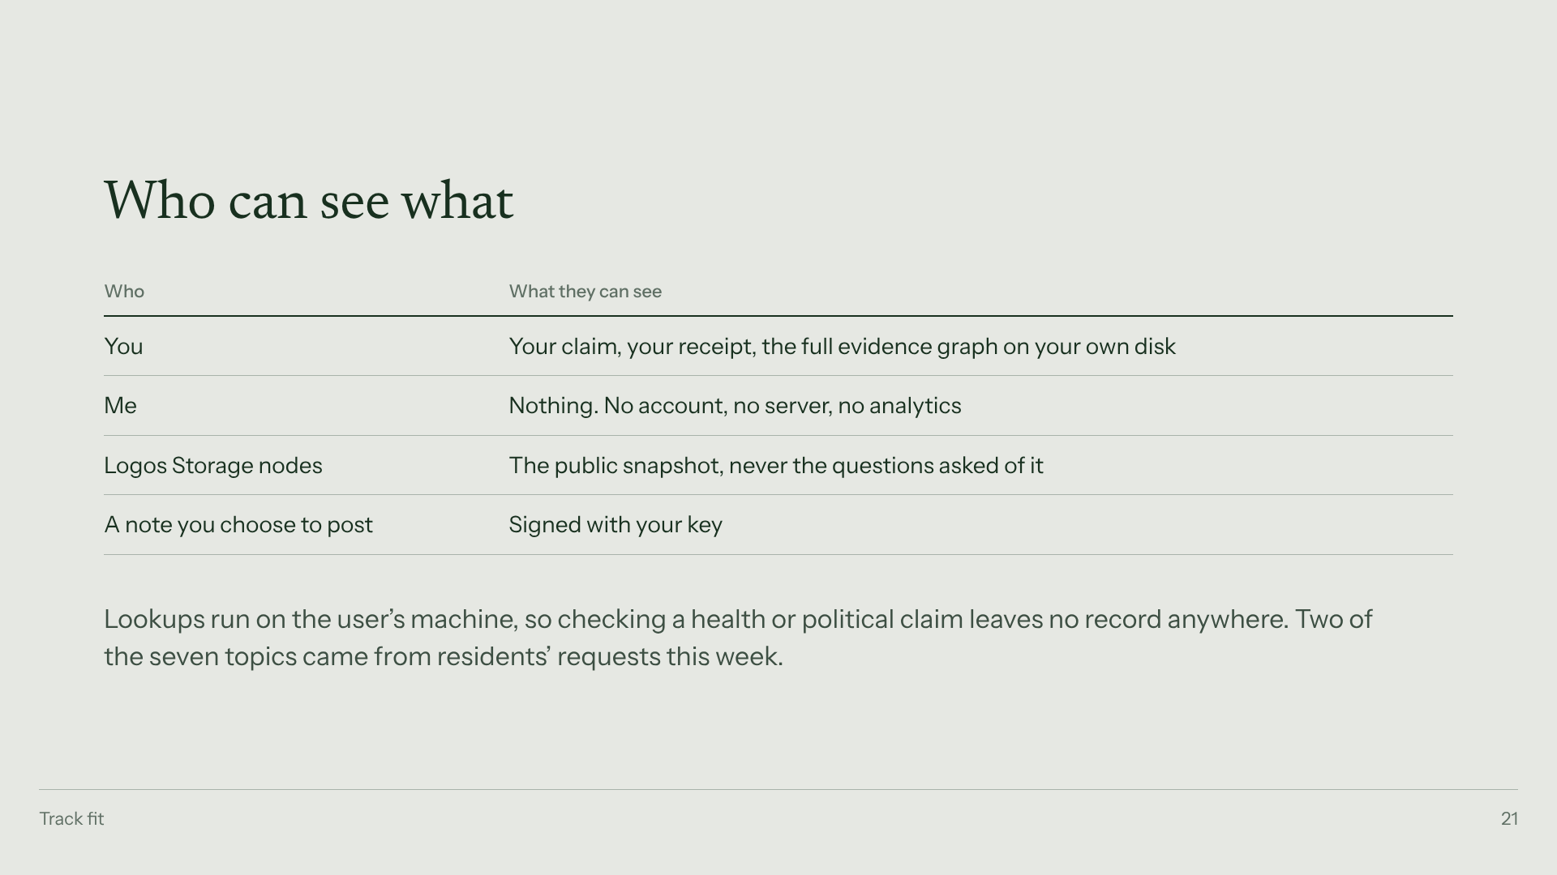
Notes:
Track B: zero data collected about the user.

Slide 22
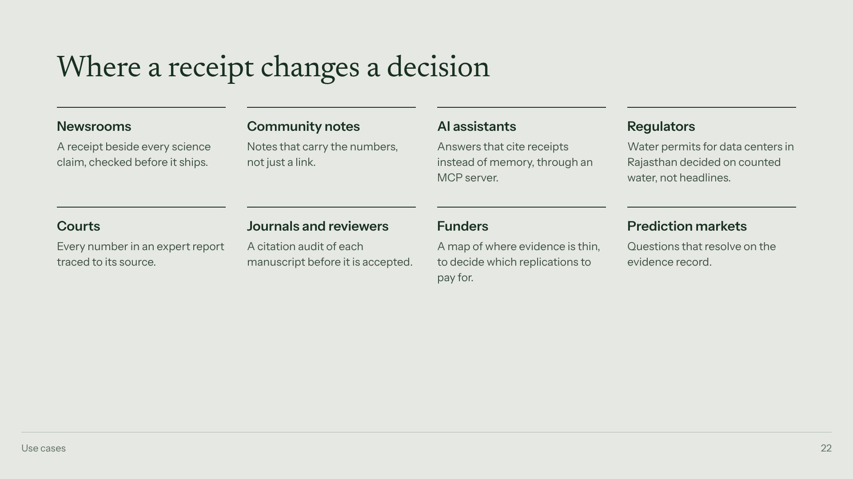
Notes:
Use cases. Pick two to say aloud: regulators in Rajasthan, and AI assistants.

Slide 23
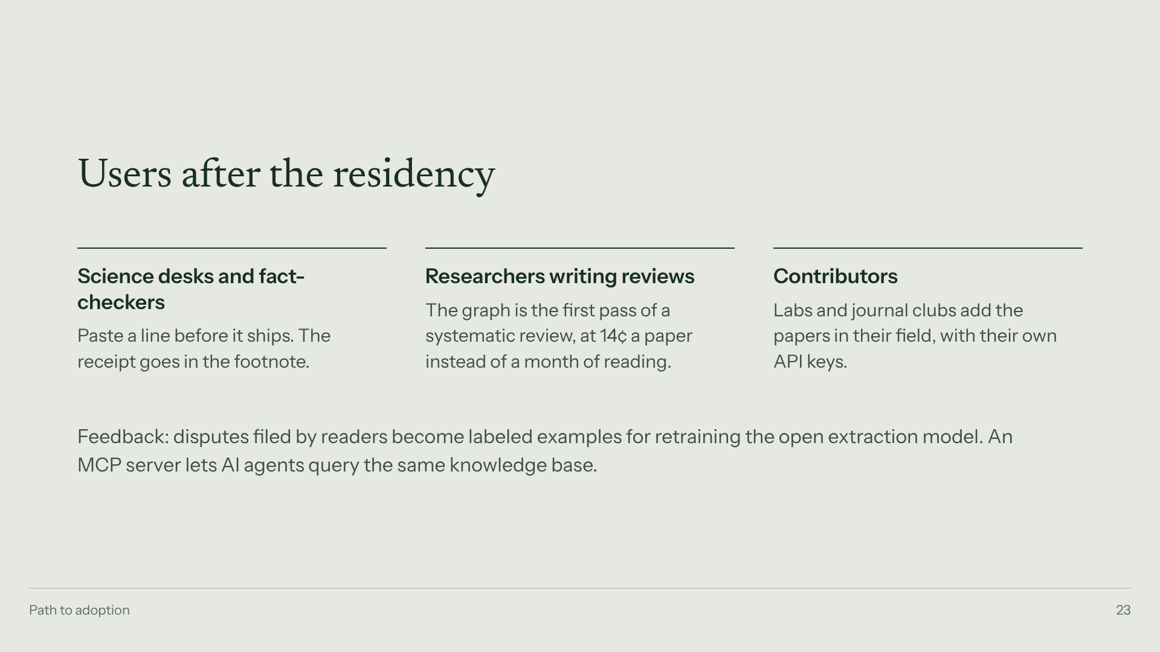
Notes:
Users after the residency and the feedback loop.

Slide 24
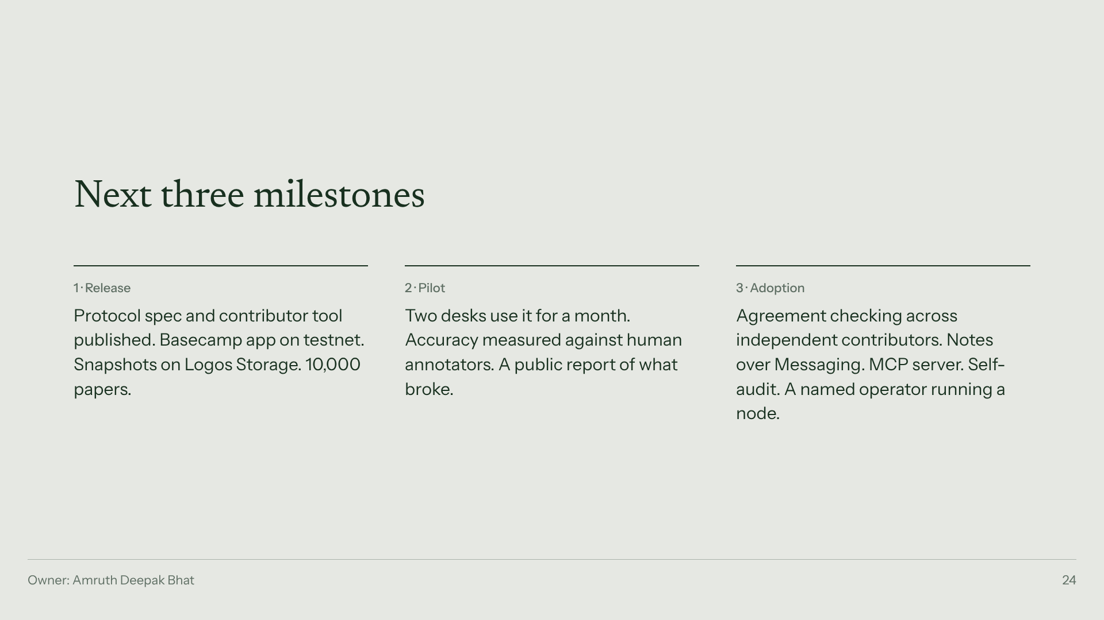
Notes:
Three milestones, one owner.

Slide 25
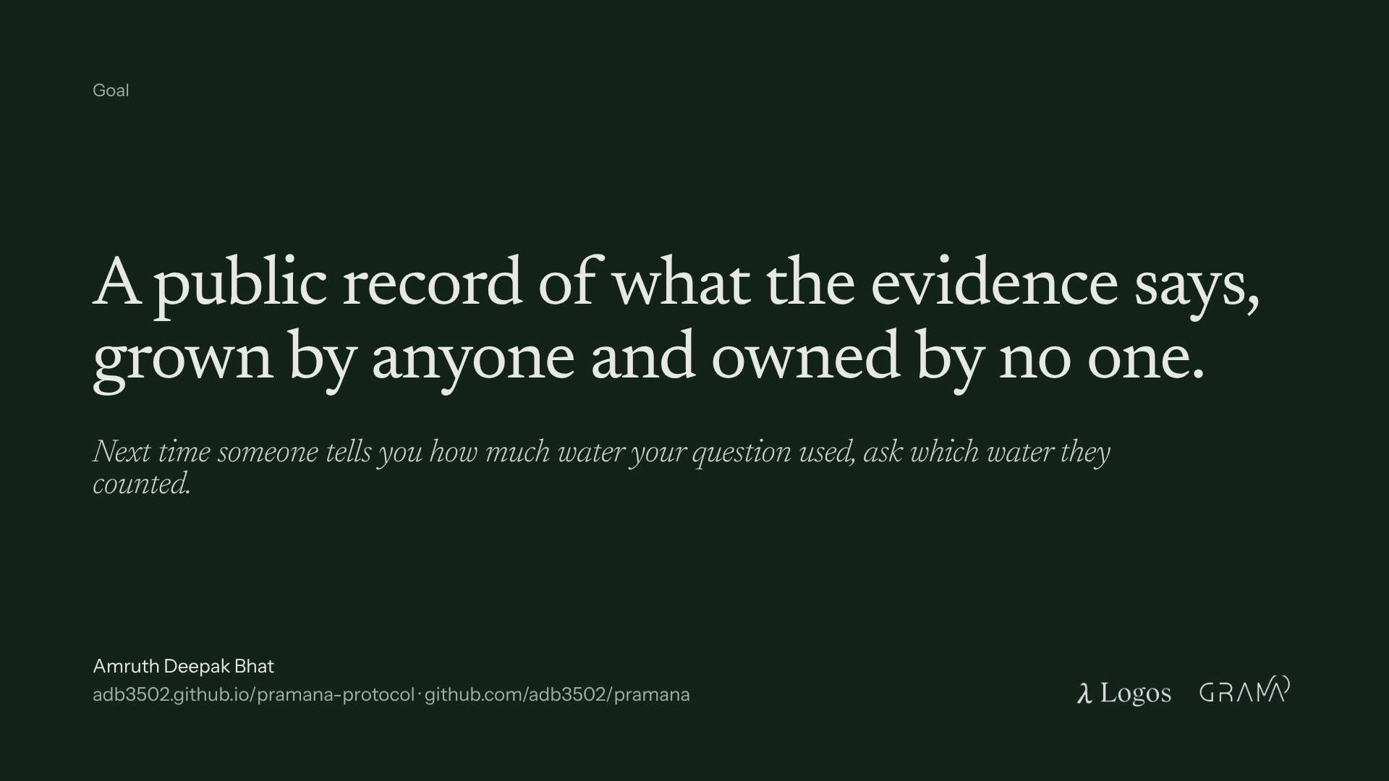
Notes:
Close. Then the callback. Stop.

